Slide 1
The $100,000,000 Sales Deck: Explanation of Slides
Slide 2 is designed to get the buyer talking about their desired business outcomes. This is where you talk about business pain.
Slide 3 is designed to get the buyer talking about root causes of their business pain. In our case at pclub.io, that comes down to skill gaps.
Slide 4 is designed to show what external change is happening in the world that makes the business pain more urgent.
Slide 5 is designed to “dismantle” existing solutions in a way that favors a purchase with us.
Slide 6 is designed to “position” our solution against existing solutions in a way that makes it a “no brainer.”
Slides 7 thru 9 are a high level introduction to our business product, at which point we transition to a live demo.

Slide 2

Low win rates (often between 16-20%) with extra low conversion in early stages.
Low quota participation with between 0% and 40% of reps meeting quota.
Here’s what we often hear.
Low revenue forecasts most sales orgs ending 70%(ish) of their rollup numbers.
Low outbound pipeline contribution usually less than 30% of pipeline.
Long sales cycles that have become more complex, more people involved, higher scrutiny, lower risk tolerance.
Struggling with cheap competitors who opportunistically position themselves as ‘low cost’ or ‘all in one’ solutions.
Notes:
Broad brushstrokes

Slide 3

Struggling to ‘layer deep’ and uncover business outcomes to sell to.
Losing deals as ‘finalists’ against the competition.
Here’s the skill gaps we’re hearing
Scrambling to build champions when it’s already too late.
Selling high and getting access to power.
Quid pro quo and ‘give for get’ during negotiations; selling the product for what it’s worth.
Product-centric and feature-heavy demos (vs. value-oriented).
Notes:
Broad brushstrokes

Slide 4

“As market conditions change, so do the skills we need to win”
“Our buyer’s behavior, market conditions, and selling environment are all changing faster than we can evolve our sellers’ skills.”
David Katz, VP Corporate Sales,
Hubspot

Slide 5
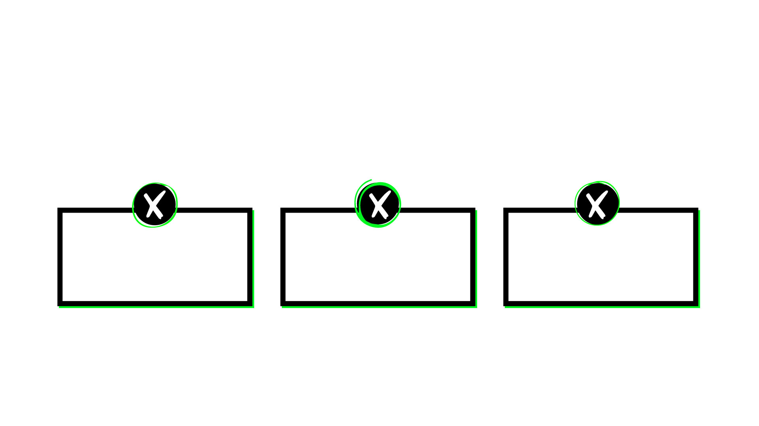


Most Sales Training Falls Short
pclub.io
Trainers Your People Don’t Trust
Stale and Out of Date
One Size Fits All
Notes:
But here’s what’s possible, and where we’re going in this course.

Slide 6

why tech sales organizations are joining pclub.io at a faster rate than any other
pclub.io
Super-Specific Skill Topics specific topics and skill levels for each unique role.
Proven Subject Matter Experts
Course authors doing these at the highest level
Up to Date for New Market Conditions Go to platform to reskill your people as the world shifts.
Notes:
But here’s what’s possible, and where we’re going in this course.

Slide 7

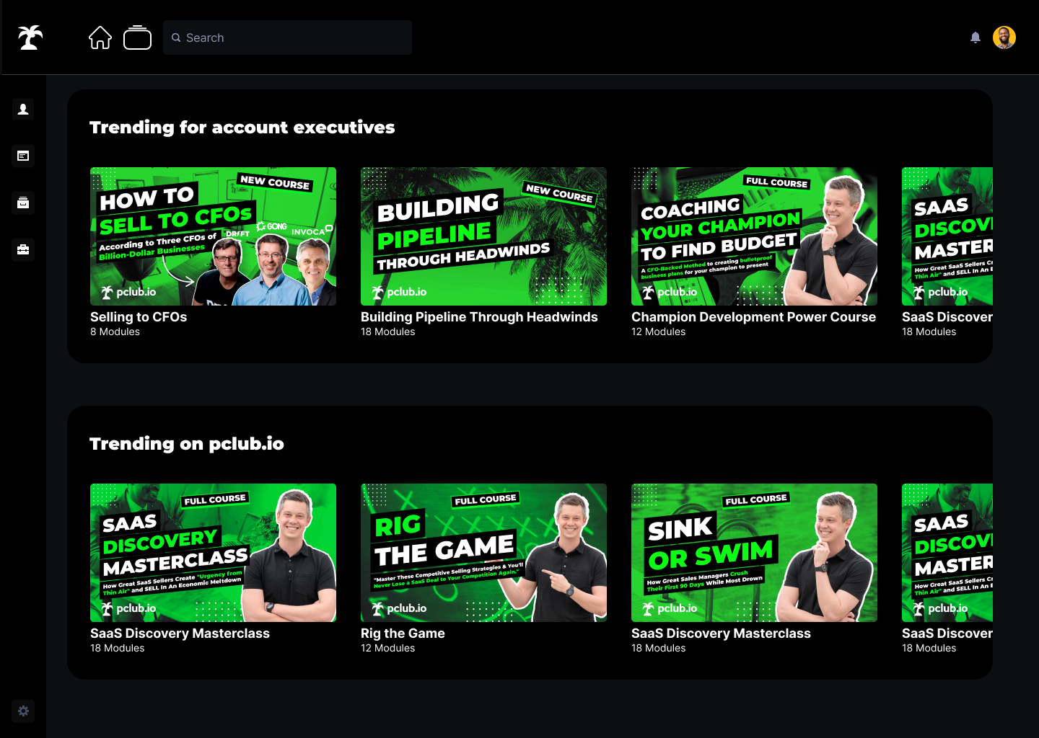

Keep Your People on the Cutting Edge.
Master every aspect of selling, as market conditions change.
Learn From Top 1% “In the Trenches” Tech Revenue Instructors
Notes:
Continually reskill and continually improve with new courses added regularly to build new skills and address new market realities (such as selling to CFOs or coaching champions to find budget in a down economy)

Slide 8













Master Every Aspect of Selling From “New Opp” to “Close” With Courses Created By Top 1% “In the Trenches” Instructors
Chris Orlob
CEO, pclub.io
Jen Allen-Knuth
Former Chief Evanglist, Challenger
Kevin Gaither
Former SVP Sales, Ziprecruiter
Florin Tatulea
Director of Sales at Barley, Outbound Saleas Experft
Rachel Shi
Strategic Account Executive at Metadata.io
Jamal Reimer
AUTHOR, MEGADEAL SECRETS
Sean Gentry
Senior Manager, Webflow
Ryan Longfield
Former CRO of Gong
Brett Baldwin
CRO
Kevin Coleman
SVP Marketing at Clari
Kyle Asay
RVP Sales at MongoDB
Trent Dressel
Account Executive, Qualtrics

Slide 9
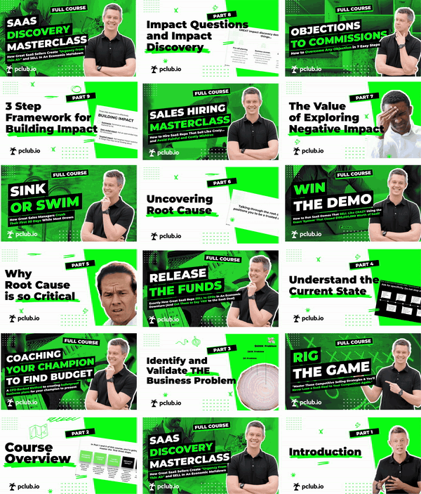
Upskill your team with personalized Skill Paths of top-rated courses
Each of your people gets a personalized Skill Path of skill-building courses from our library 5-star-rated tech sales courses from the top 0.01% of tech sales practitioners.
Notes:
Create and Auto-Generate Skill Paths
Based on their role, assessment results, and skill gaps, every rep and manager gets a personalized Skill Path of skill-building mini courses, micro content, and assessments from our library of 100+ 5-star-rated tech sales courses, auto-suggested by our Matching Engine and co-created with their Coach

